Slide 1
SEC Highway 31 & Poplar Springs Rd. – Executive Summary
Property Description:
The proposed site is located at the Southeast corner of the intersection of Highway 31 and Poplar Springs Road. Visibility from 2 public roadways is excellent and access includes a Full Movement access point with Signal on US Highway 31 and two (2) Full Movement access points on Poplar Springs Road. Signalized intersection shared with Wal-Mart Supercenter. Monument signage on both roads is allowed for the parcels.
Trade Area:
A trade area demographic report was performed on a 3, 5 and 7-mile radius from the proposed location. Based on this trade area, current population counts are 7,975 (3-mile), 13,986 (5-mile), 18,893 (7-mile), with a average household income of $54,928 and median age of 39.6 in the 5-mile trade area. Wal-Mart Supercenter is directly across the street.
Chilton County High School, Clanton Middle School, and Clanton Elementary School are all adjacent to the site with total student population of around 2,400 students and 350 staff members.
Site Traffic Counts:
Highway 31 has a traffic count of 16,280 ADT.
Area Retailers:
Wal-Mart Supercenter – directly across Highway 31
Tractor Supply, Zaxby’s,Wendy’s, Cato, Hibbitt Sports, Pizza Hut, and Dollar Stores in immediate vicinity on Highway 31

Slide 2
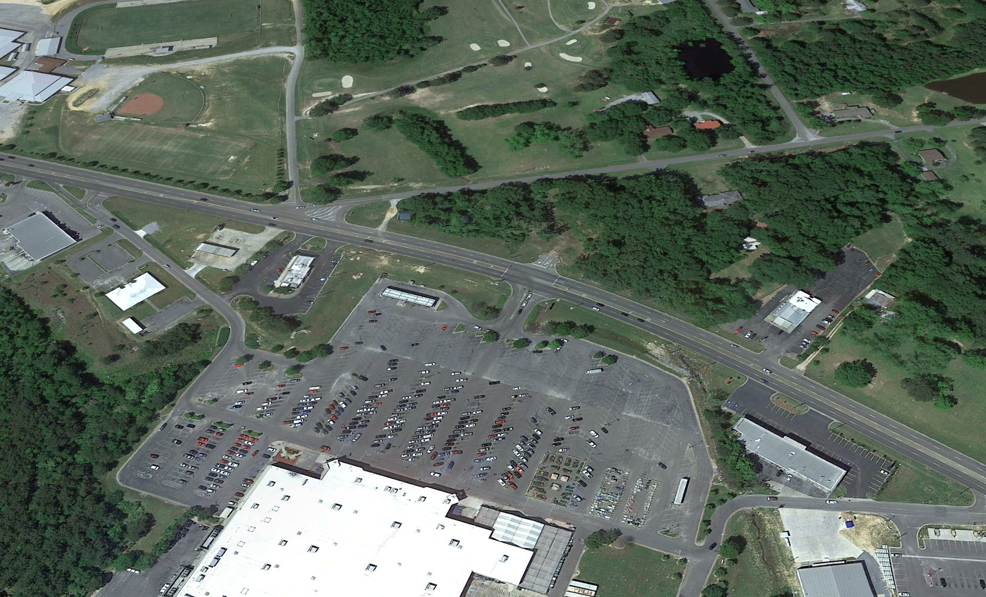
SEC US Highway 31 & Poplar Springs Road, Clanton, AL– Overhead
Clanton Country Club GC
Chilton Co. H.S.
950 Students
N
Country Club Rd
Poplar Springs Road
Parcel 1
.53 acres
Parcel 3
1.66 acres
US Hwy 31 -16,280 ADT
Retail Strip

Slide 3
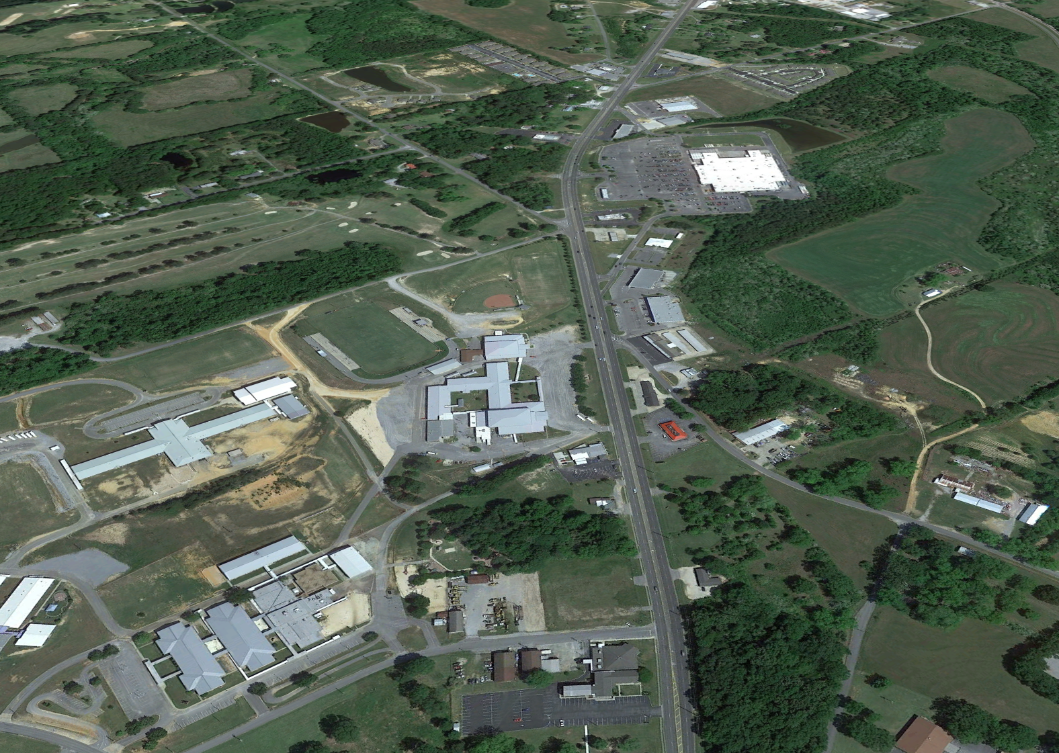
SEC US Highway 31 & Poplar Springs Road, Clanton, AL– Looking Southwest
N
Site
Poplar Springs Road
Clanton Country Club GC
Country Club Rd
US Hwy 31 -16,280 ADT
Chilton Co. H.S.
950 Students
Clanton M.S. 700 Students
Clanton E.S.
750 Students

Slide 4
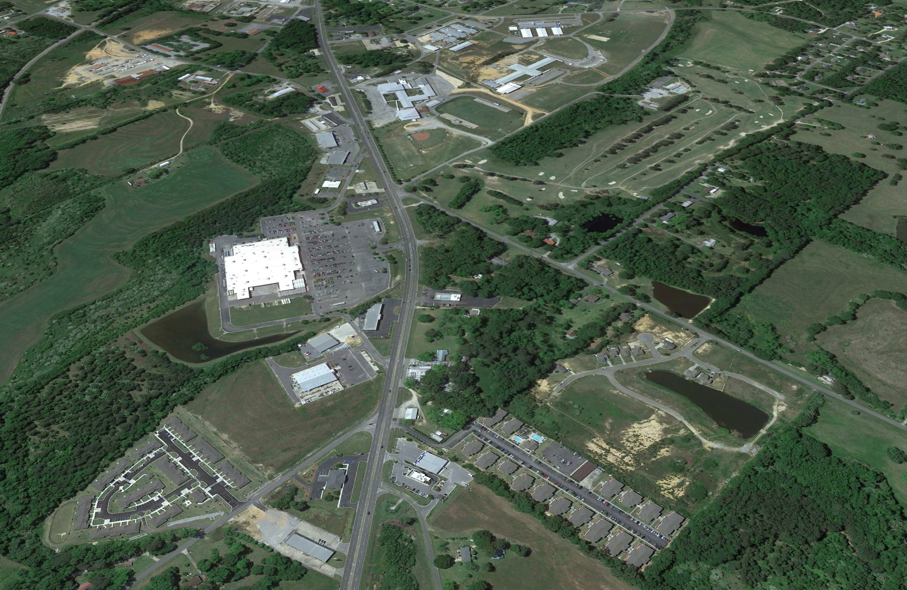
SEC US Highway 31 & Poplar Springs Road, Clanton, AL– Looking Northwest
Clanton E.S.
750 Students
Clanton M.S. 700 Students
N
Chilton Co. H.S.
950 Students
US Hwy 31 -16,280 ADT
Clanton Country Club GC
Country Club Rd
Site
Poplar Springs Road
Retail Strip

Slide 5
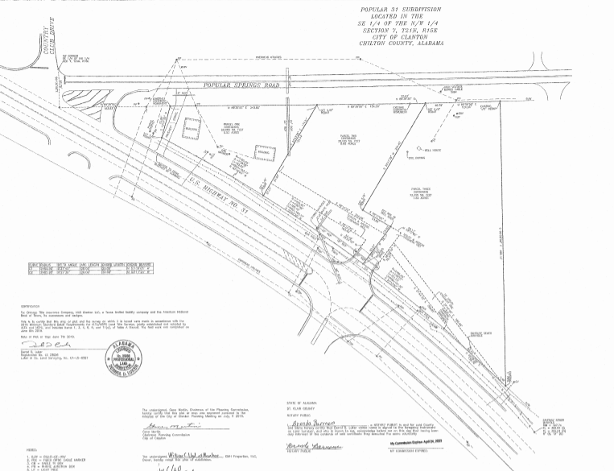
SEC US Highway 31 & Poplar Springs Road, Clanton, AL – Plat
Parcel 1
.53 acres
Parcel 3
1.66 acres

Slide 6
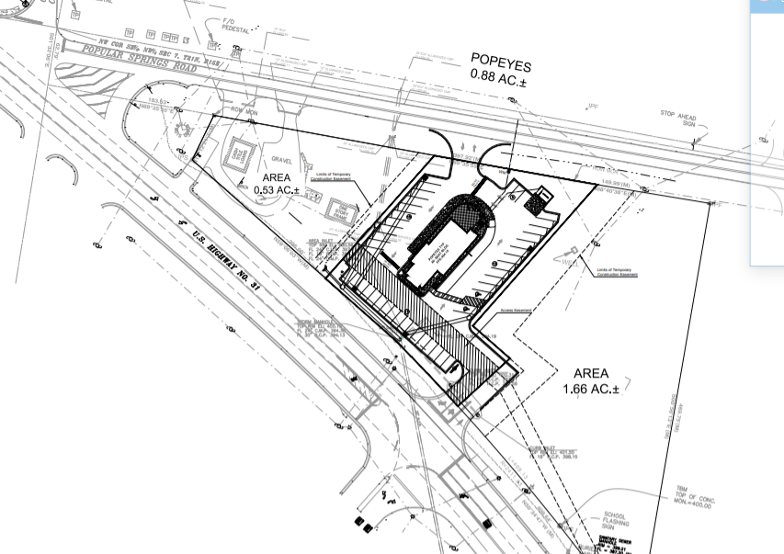
SEC US Highway 31 & Poplar Springs Road, Clanton, AL – Popeyes Site Plan

